Slide 1


The Next Move of God
Elevation Life Center – Growing to 200 Members & $250,000 by 2027

Slide 2
1.LOVE OF GOD
Worship, prayer, discipleship
2.LOVE FOR PEOPLE
Outreach, hospitality, care ministry
Our New Vision –
The 3 Pillars
3.LOVE IN ACTION
Serving, giving, and building for the future

Slide 3
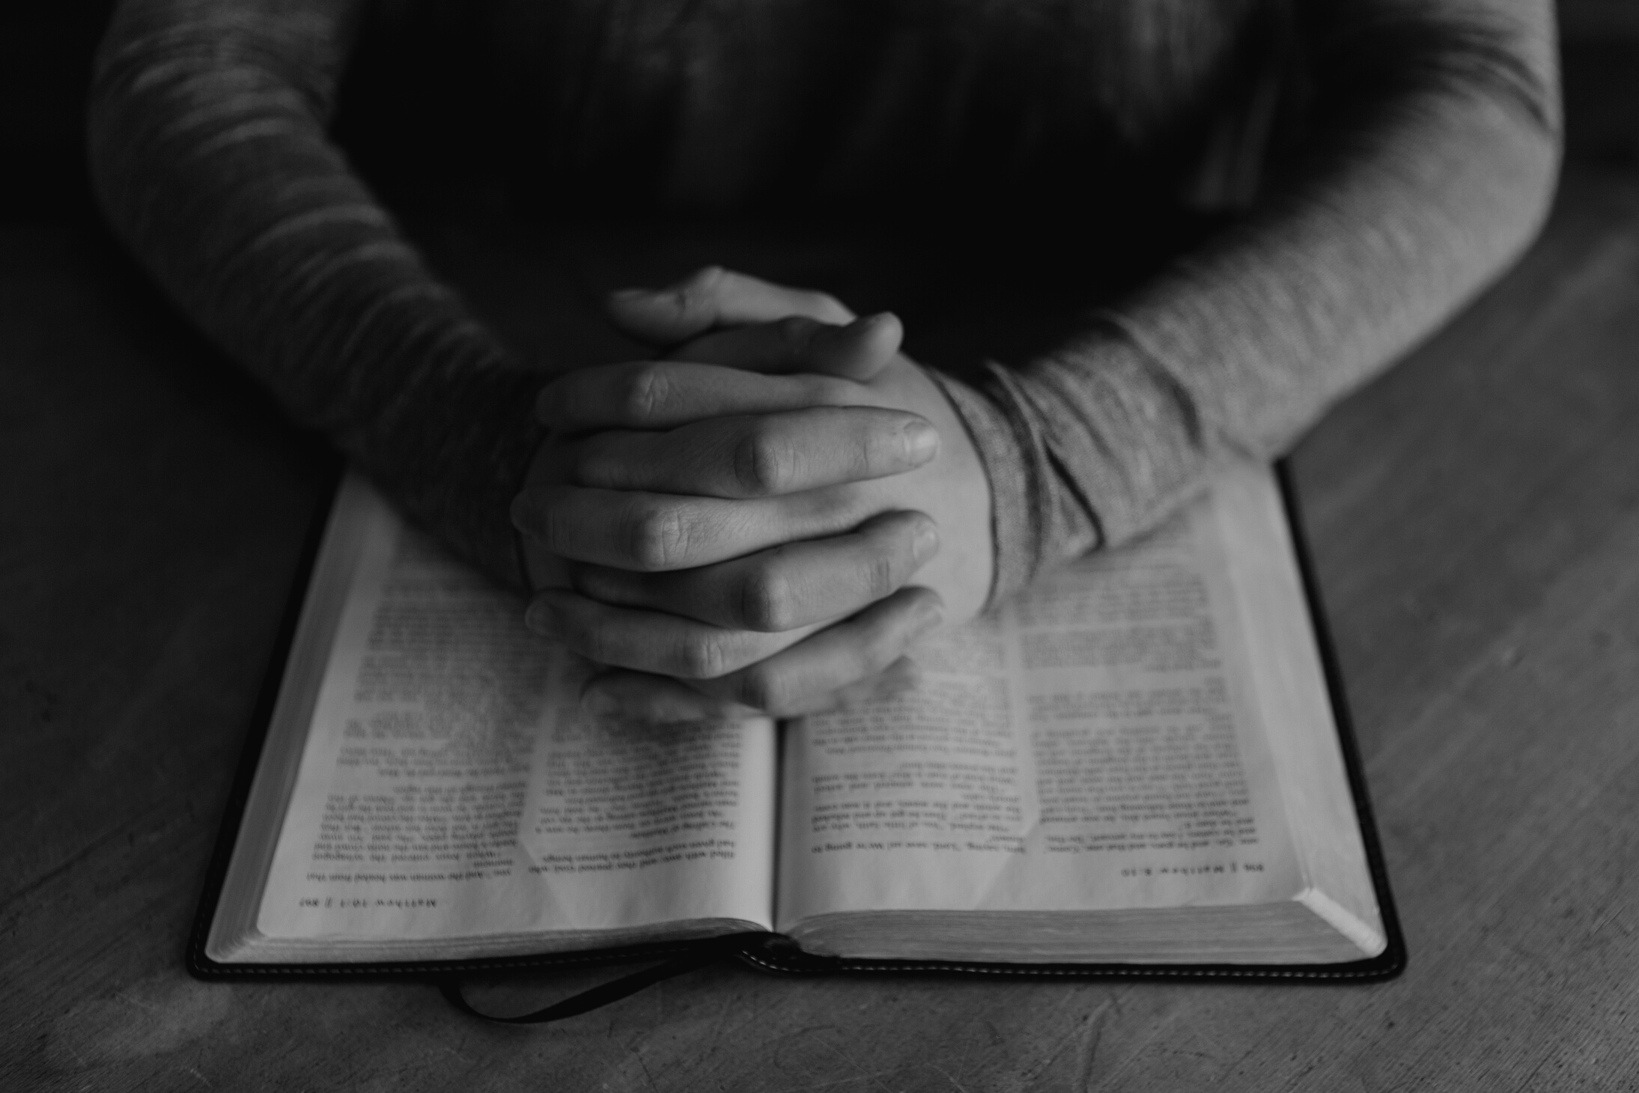
Vision and Goal
  Grow Elevation Life Center to 200 members
  Reach financial goal of $250,000 by August 2027
  Relocate into a new facility
  Scripture: Habakkuk 2:2 – 'Write the vision; make it plain…'

Slide 4


F = FAMILY
R = RECREATION
Get to know their family story
F.O.R.M. Update – Building Relationships
What do they enjoy doing?
O = OCCUPATION
M = MOTIVATION
We use F.O.R.M. to connect people deeper into the church family.
Ask about their career/work
What drives and inspires them?

Slide 5
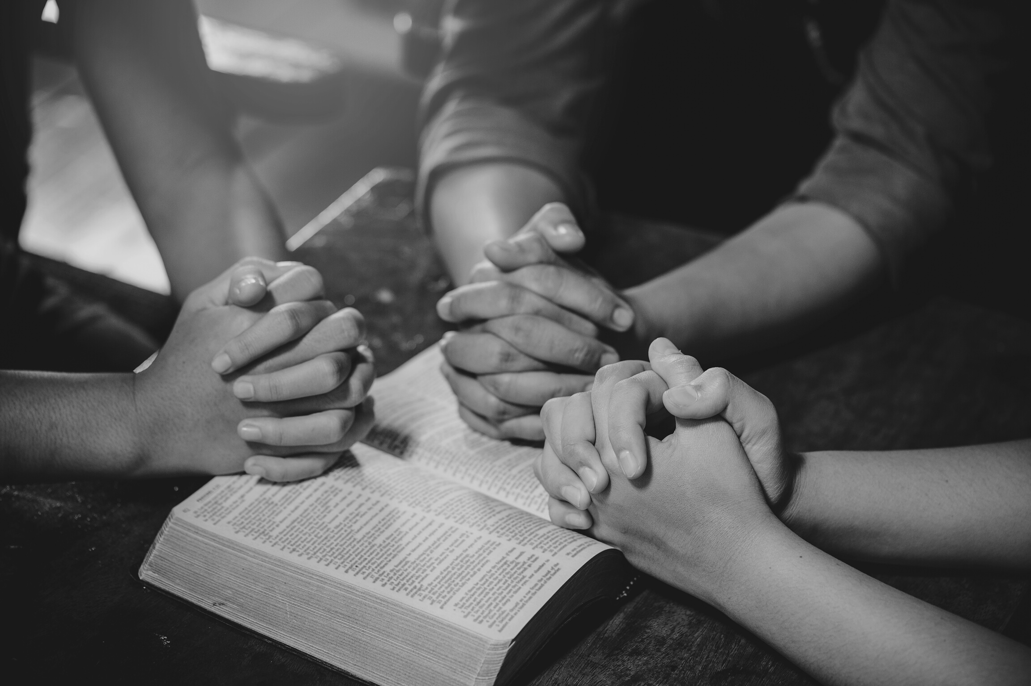
10 Things Every Member Can Do
  Pray daily
  Invite 2 people to church
  Share & like church posts
  Serve in a ministry
  Give faithfully
  Bring s Spirit of Worship
  Be an ambassador for ELC
  Join outreach opportunities
  Disciple someone
  Speak the vision boldly
SCRIPTURE: ACTS 2:47

Slide 6
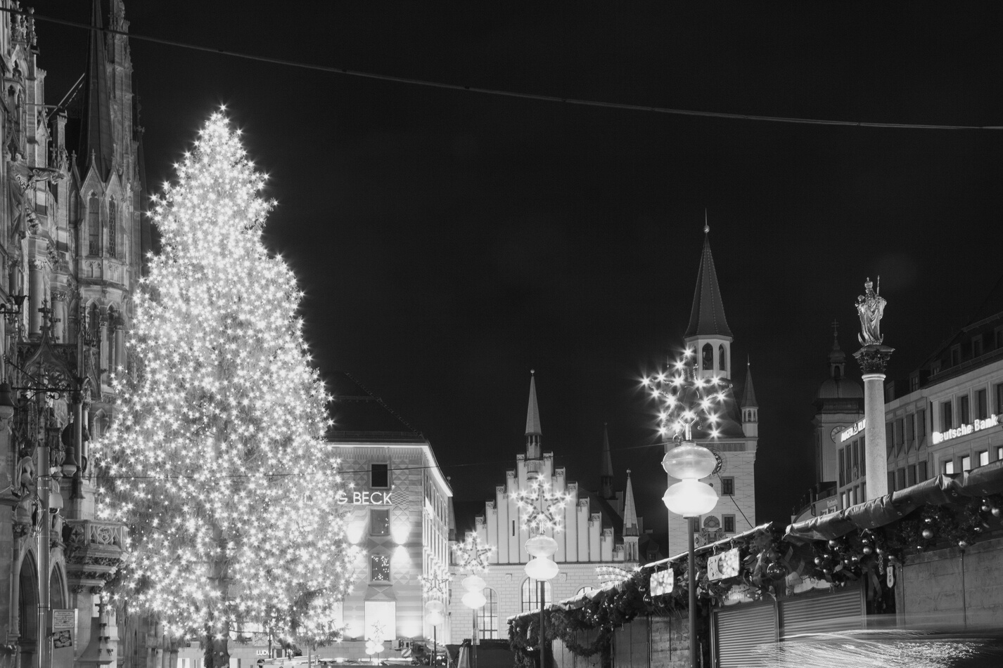
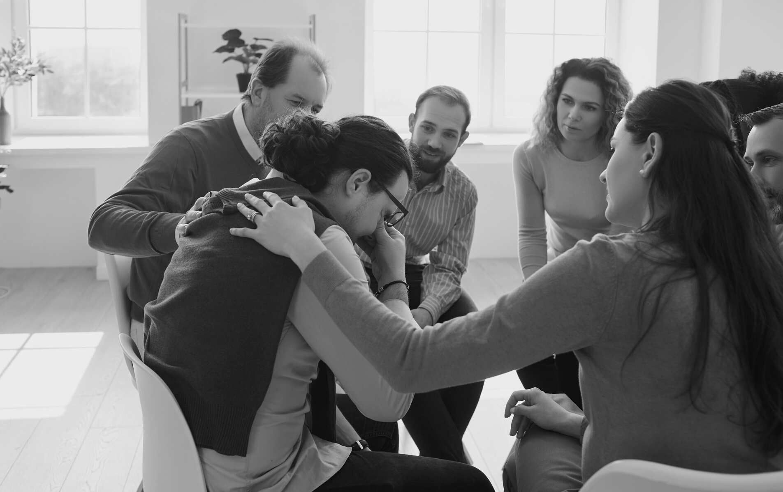
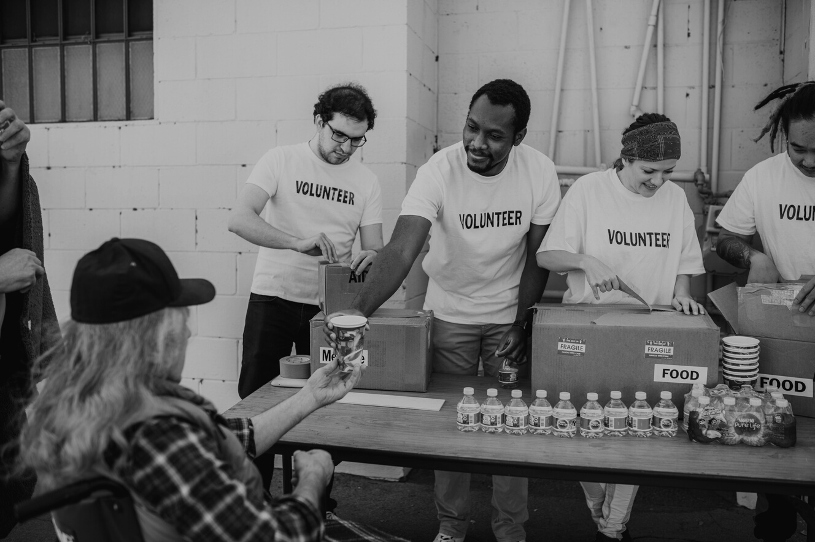
Outreach Strategy
COMMUNITY OUTREACH:
RELATIONAL OUTREACH:
SERVICE OUTREACH:
Back-to-School, Thanksgiving, Christmas, Easter
Each One, Reach One / Invite Nights
Free Gas, Nursing Homes, Schools

Slide 7
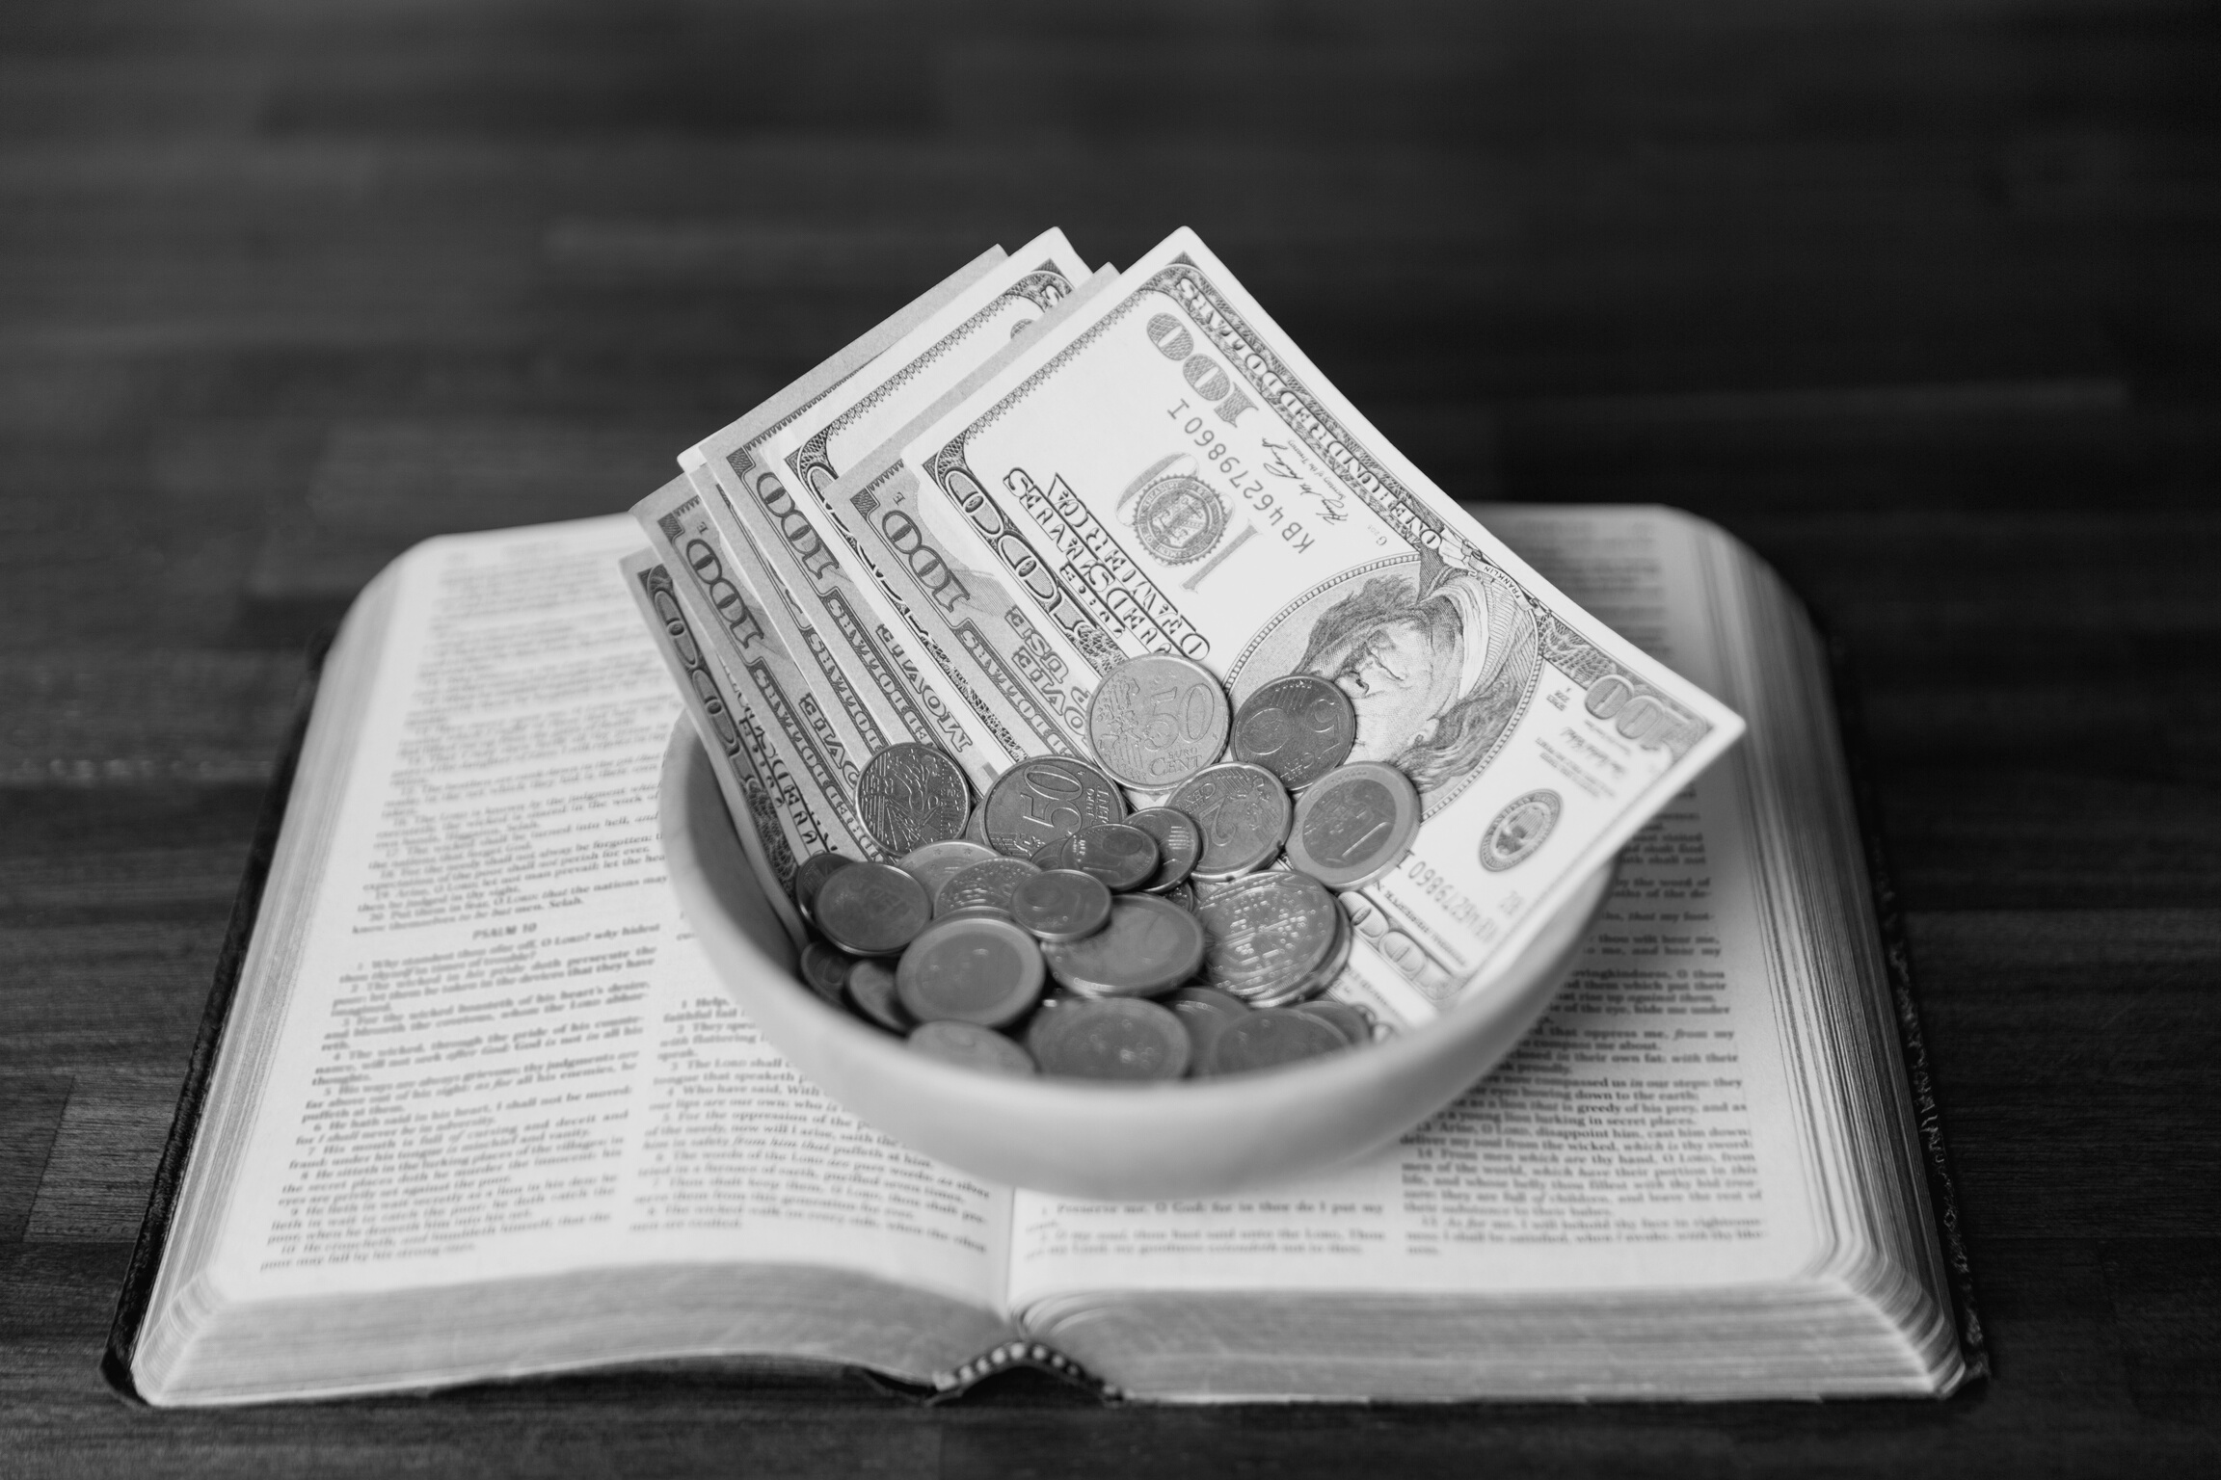
Serving & Giving
SERVING:
  Every member finds one place to serve
  Excellence in service makes visitors stay
GIVING:
  Tithes = obedience
  Offerings = generosity
  Sacrifice = legacy (Next Seed Fund)
  Scripture: Malachi 3:10

Slide 8

Communicating the Vision
  Speak life: 'We are building The Next Move of God.'
  Share Testimonies Tuesday
  Encourage others to pray, serve, give, and share
  Use every conversation as an invite

Slide 9
New Teams and Events
SOCIAL MEDIA TEAM
Creating content, managing platforms
TESTIMONY TUESDAY
Sharing stories of God’s goodness
NEW EVENTS
Outreach, fellowship, growth opportunities
EVERY MEMBER HAS A ROLE TO PLAY IN BUILDING THE NEXT MOVE OF GOD

Slide 10
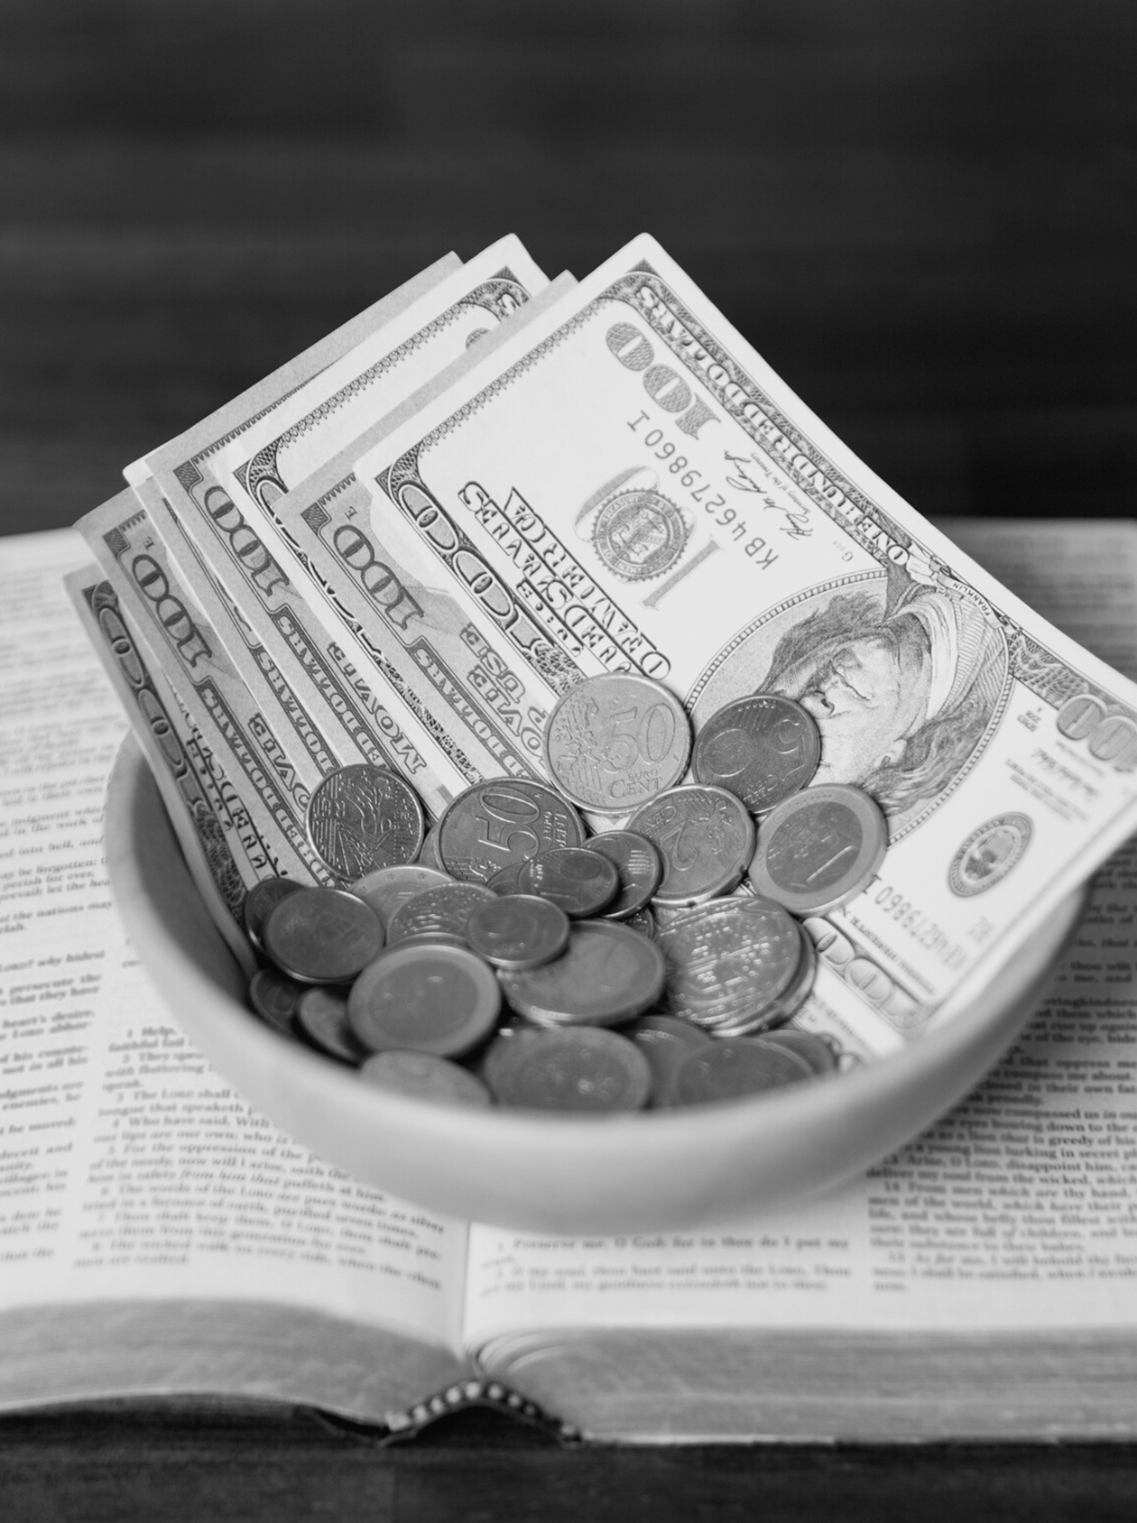
Call to Action
PASTOR JAMES & ANGELA SCRUGGS
  Choose your role: Prayer Warrior, Server, Giver, Sharer
  Commit today: Invite, Give, Serve
  Together: 200 Members & $250,000 by 2027
  Declaration: 'We will rise up and build!'

